Slide 1
EchoGesture
Welcome to EchoGesture, where we bridge communication barriers with innovation. We're passionate about creating accessible solutions that empower individuals to connect seamlessly through sign language.
Our platform transforms audio and text into clear and expressive sign language, making communication inclusive for everyone, regardless of their hearing abilities.
With a commitment to accessibility and inclusion, we strive to enhance communication experiences for the deaf and hard of hearing community worldwide.
Join us in breaking down barriers and fostering a world where communication knows no bounds.

Slide 2
Features:
EchoGesture serves as a groundbreaking bridge in communication for the deaf and hard-of-hearing community, providing them with a more inclusive and accessible way to understand spoken language.
This innovative tool not only empowers individuals with hearing impairments to engage more fully in everyday conversations, educational content, and public speeches but also fosters a greater sense of connection and understanding between the hearing and non-hearing worlds. By breaking down these communication barriers, the website plays a crucial role in promoting equality, accessibility, and inclusivity in society.
This website executes three types of conversions:
Voice to Sign Language
Text to Sign Language
Different Letters of Alphabet in Sign Language

Slide 3
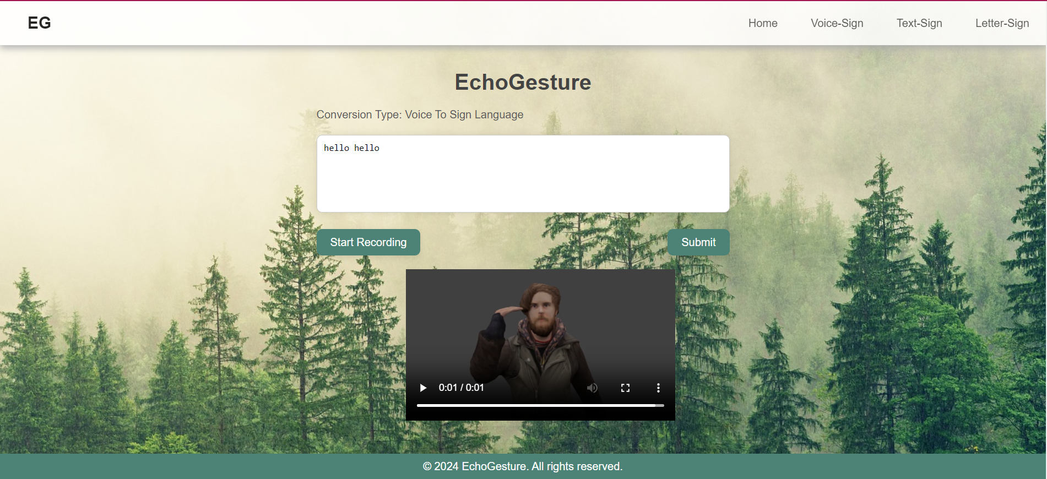
Voice to Sign language:

Slide 4
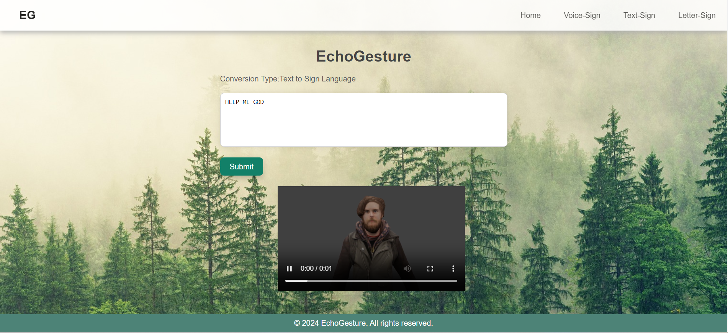
Text to Sign Language:

Slide 5
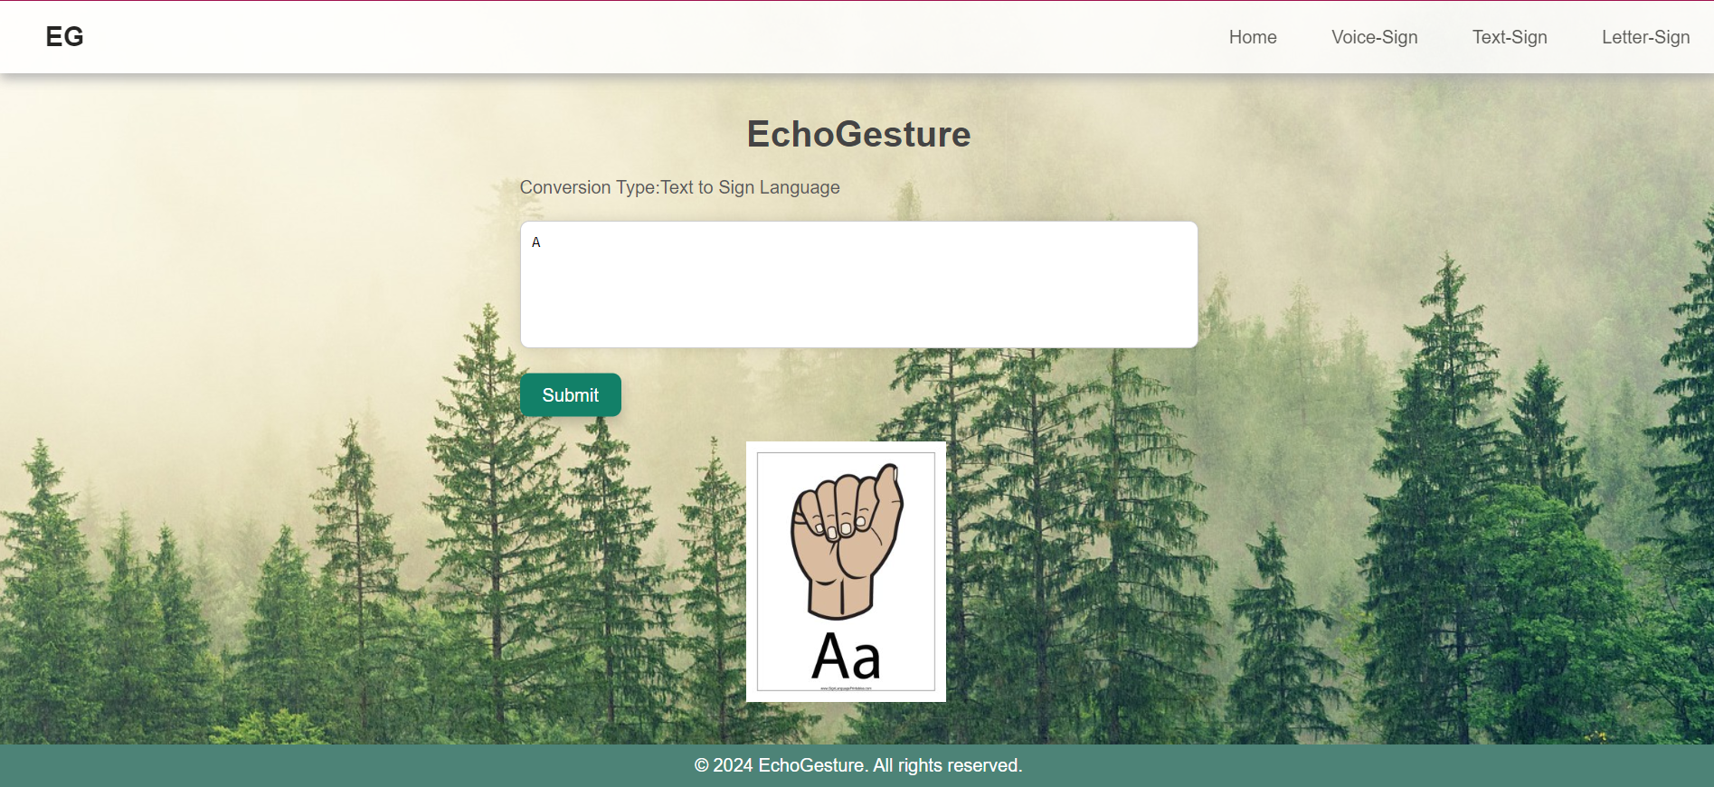
Letters in Sign Language:

Slide 6
Tools Used
HTML
CSS
JAVASCRIPT
INVENTIONTRICKS.COM

Slide 7
Contributors:
Priyanshi Maheshwari
Rachit Kansal
Love Bansal
Shaurya Singh

